Slide 1
Water Potability Prediction
Team
1. Divit SHAH
2. Atharv Chaudhari
Project Details
Theme – Water Pollution
Domain – Classical Machine Learning
Dataset – Pubic dataset(kaggle)

Slide 2
Introduction
Objective of the project
Potability Prediction : To develop a machine learning model which can predict if water is potable/drinkable or not.
Importance of Water Potability
Whether water is utilized for drinking, household usage, food production, or recreational activities, it is crucial for the public's health to have access to safe, readily available water.
Drinking water, also referred to as potable water, is obtained from surface and underground sources and treated to satisfy state and federal criteria for consumption.

Slide 3
Data Overview
Source of Data
Public Dataset from Kaggle
Number of Samples and Features
9 independent variables and 1 dependent(Ground Truth)
1998 instances of the negative class (Not Potable) and 1278 instances of the positive class (Potable) i.e. a total of 3276
Listed below are the 9 features required to predict the potability of water.
ph
Hardness
Solids
Chloramines
Sulfate
Conductivity
Organic Carbon
Trihalomethanes
Turbidity

Slide 4
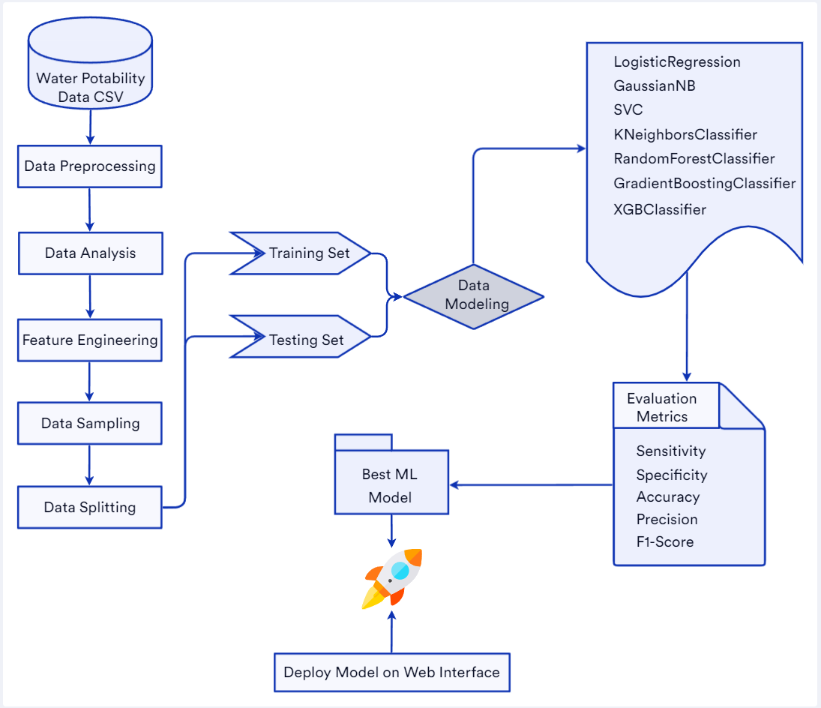
System Architecture

Slide 5




Technology Stack
Model Development – Python, Scikit-Learn
Dataset – Kaggle
Web Application Development - Streamlit

Slide 6
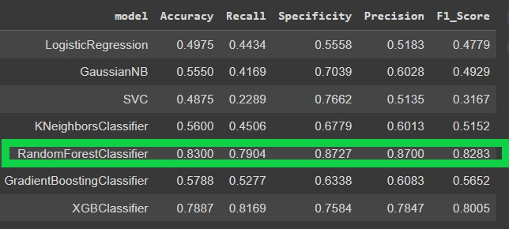
Model Selection Process
Assessed model performance using metrics such as Accuracy, Recall, Specificity, Precision, F1_Score.
Defined the confusion matrix to visualize model performance.

Slide 7
Future Scope and Conclusion
Future Scope
Future work may involve incorporating additional features or exploring more advanced modeling techniques.
Further, a IOT device providing the input parameters can be built using the required censors which can then be paired with this model to provide real time results. If the device is made to be pocket friendly it can be carried and used on the go.
Conclusion
Successfully developed a robust Random Forest Classifier model for predicting water potability.
The model demonstrates high accuracy and performance, providing a reliable tool for water quality assessment.
The implementation of median imputation further enhanced its predictive capabilities.

